Slide 1
A bit about me Lisa Roberts
I have worked for 25 years as an independent cultural producer of socially engaged arts, museums and hand-held tech. I use audio and text to bring people closer to their cultural heritage and connect people, place and object using mobile devices and locative media technology.
City Poems in 1999 was an evolving site-specific text message poetry platform for the city of Leeds. It was later adapted into a multilingual platform for Antwerp’s World Book Capital.. In 2003 for Leeds City Museums I created Mobile Museum where I created short poems for objects in the permanent displays of six very different museums national Royal Armouries Museum to the local Industrial History Museum.
In 2021, I developed a bespoke RFID audio discovery system with Daniel Blackburn, to create an immersive audio piece inspired by Saila Susiluoto’s ‘Book Of Rooms’ (Huoneiden Kirja). It was awarded the Finnish State Prize for Performing Arts. Daniel is a creative technologist and software developer. He built and manages Food Buddy and Where In The World? interactive exhibits in Fazer Visitor Centre and the Reuse it! exhibit at LSJH visitors centre in Salo.

Slide 2
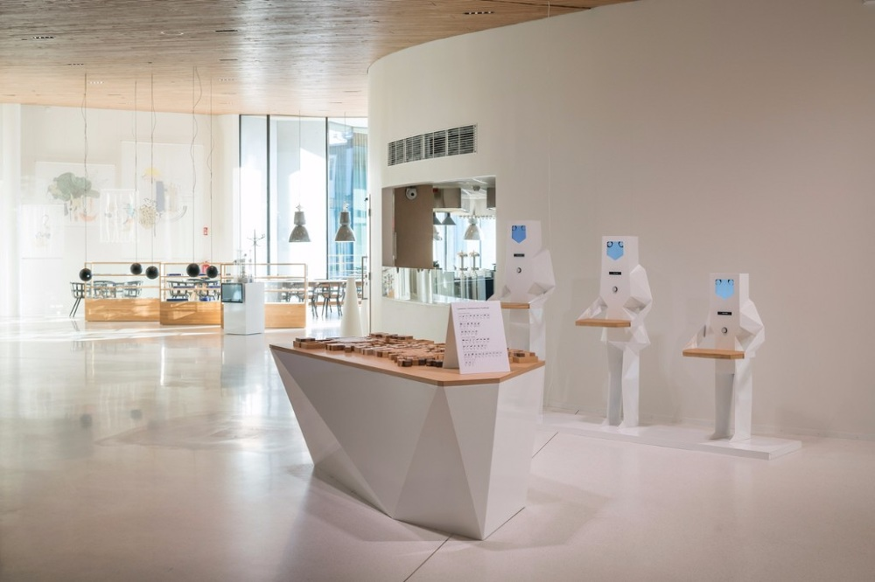
Food Buddy at Fazer Visitor Centre

Slide 3
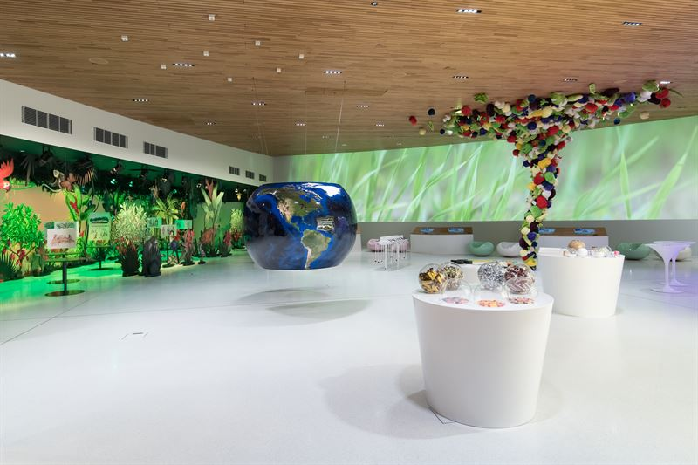
Where in the World? at Fazer Visitor Centre

Slide 4
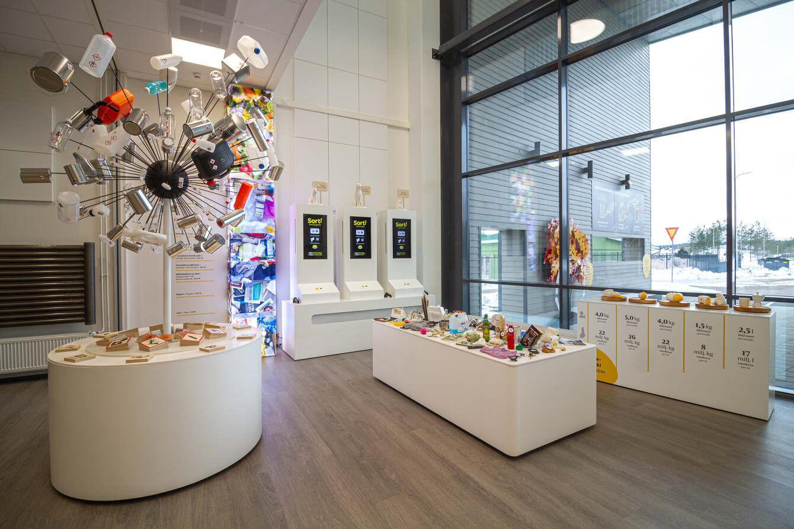
Reuse It! at LSJH visitor centre, Salo

Slide 5
FOUND
A new socially-engaged arts and cultural heritage project that enables access, inclusion and meaningful engagement in museums

Slide 6
“In the past, museum objects were often catalogued without any information related to origin, provenance or donor. Museum professionals in the mid 20th century were more interested in only the details of the physical descriptions. There are also objects which have been brought to museums and have not been catalogued at all. These reside in a kind of limbo. Many larger museums have thousands of these objects stashed away that were donated 50 or even 100 years ago. Some of the larger museums have rooms dedicated to them.”
John Björkman Director of Sagalund Museum, Finland
FOUND

Slide 7
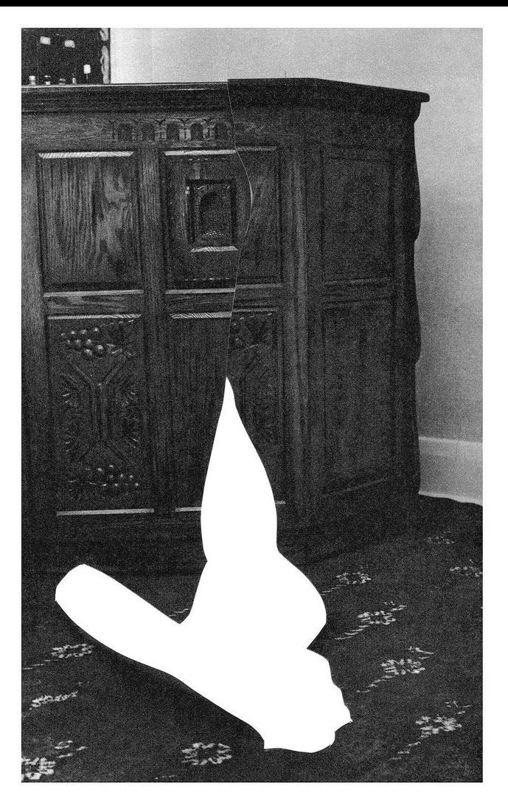
FOUND
Objects that have lost their identity are in a kind of limbo. Museums are bound by their obligation to preserve and care. Such objects are never or rarely exhibited.
In an ever-changing world people can also become uncategorizable, trapped in bureaucratic systems of control and become marginalised and anonymous.
FOUND gives everyone a chance to consider difficult subjects by talking about historical objects.

Slide 8
FOUND
FOUND is a collaborative, audio project which unlocks collections and breaks down barriers to entry through the re-presentation of anonymous objects. It is a public outreach initiative that generates and collects creative responses and shares audio in the museum using a playful interactive audio exhibit.
FOUND physically and emotionally connects people with their long lost past. Communities will be involved in making and the playful interaction. FOUND creates a sense of ownership through meaningful engagement.
FOUND includes and shares diverse voices, language and heritage through community-generated content.

Slide 9
FOUND
FOUND raises important questions
How do things become lost?
Why is such a large amount of cultural heritage inaccessible?
What kinds of things are never seen and why?
How can museums with ageing collections find new narratives and respond to current sensitivities?
How can museums survive criticism of their authority and social utility?
On what basis do we trust historical fact?

Slide 10
FOUND
Informs our futures
During the production process every participant will help to fill in information gaps with their own creative responses. They will meditate on the objects and use their imagination to write stories and poems and talk. I will lead simple, fun and inspirational creative writing challenges to encourage observation and stimulate the imagination. I will interview individuals and enable them to record themselves talking.I will set up multiple ways to take part by creating Youtube video demos, Tiktok talks, Instagram diaries, web forms, Whatsapp groups, web based recorders, drop-in sessions, private recording booths, work onsite and offsite. Each session will be customised to suit each group.

Slide 11
FOUND
Inclusive, engaging, multisensory experiences.
All ages, language groups and abilities will take part in the production and the exhibition. Community groups and school groups. Senior groups can use FOUND as form of reminiscence therapy.
Family groups, people with impaired-vision and non-readers can take part. Asylum seekers, prisoners, immigrants, non readers and everyone largely missing from the historical record will be invited to take part. By capturing real voices we will hear the personality of the individual, language and dialect of the author.
FOUND can help to fulfill the democratic potential of your venue and broaden and diversify your customer base.
Sisters with transistors

Slide 12
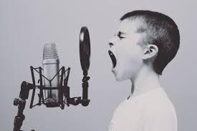
FOUND
We will also hear from those other hidden gems – museum curators and archivists.
Your contribution will help break down barriers to engagement.

Slide 13
FOUND
Why audio works in museums
Instead of reading captions or catalogues, we can discover new things through the words and voices of real people.
Treasure hunts capture the imagination and a deeper level of engagement than other kinds of museum offering.
Low light levels make information panels hard to read.
Audio can more easily be translated into a number of different languages. Audio recordings can include oral history, intangible cultural heritage, songs and poems and capture young voices.

Slide 14
FOUND
What will the final exhibition look like?
The objects will be placed around the museum ; on plinths, within the permanent display behind glass, in unexpected places - hiding in a corner or on the front desk

Slide 15
FOUND
Suggested method
Work with the archivists to select enigmatic and anonymous objects
Conduct on/off-site, public and staff storymaking workshops.
Edit
Build the RFID audio system and add tags to objects.
Create 3D replicas where necessary.
Install new installation in the museum
Staff demo showing how to use it so they can inform future visitors.
Launch the FOUND installation
Add all audio and written documentation to the website and add it to the museums archive

Slide 16
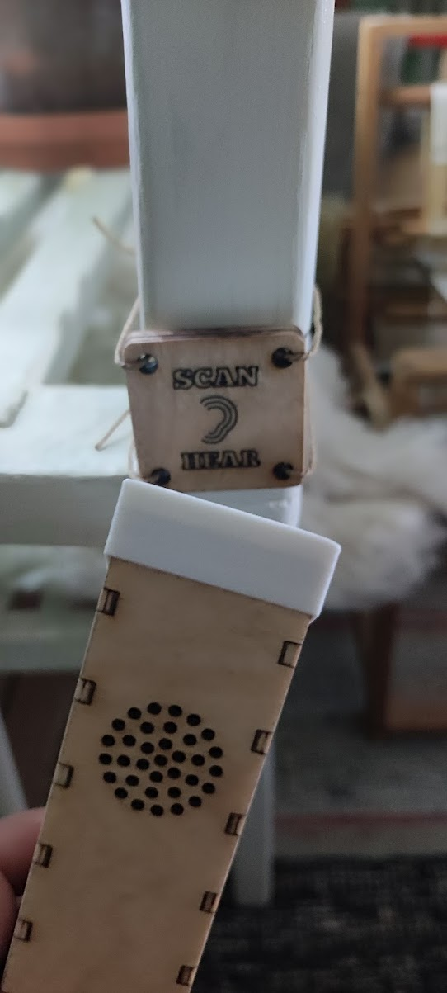
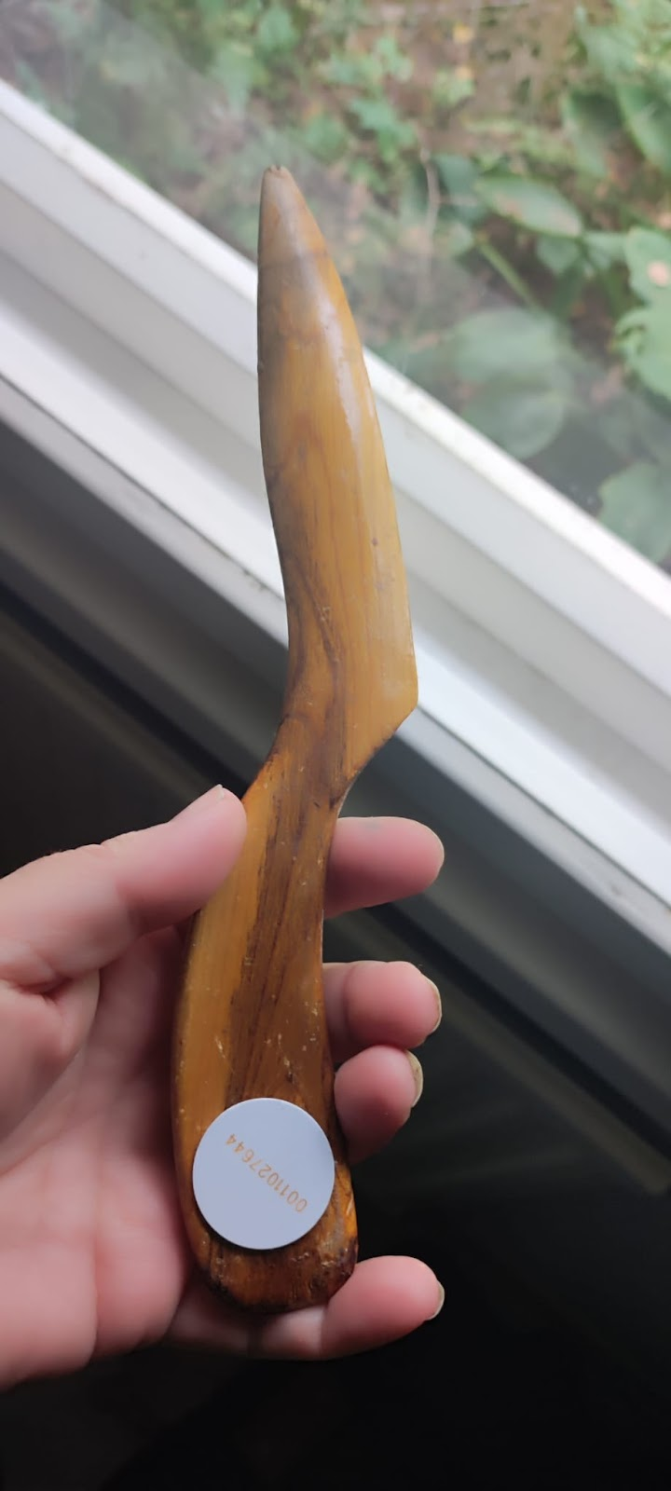
FOUND
Objects will be brought out of the archive and placed in the public areas of the museum. The objects will become triggers for playful discovery and deeper forms of engagement.

Slide 17
FOUND
FOUND will be active in the following areas.
Kemiönsaari, Pargas and Raseborg
—---------------------------------------------------------------
lisaroberts.fi
+358 41 7502687

